Slide 1
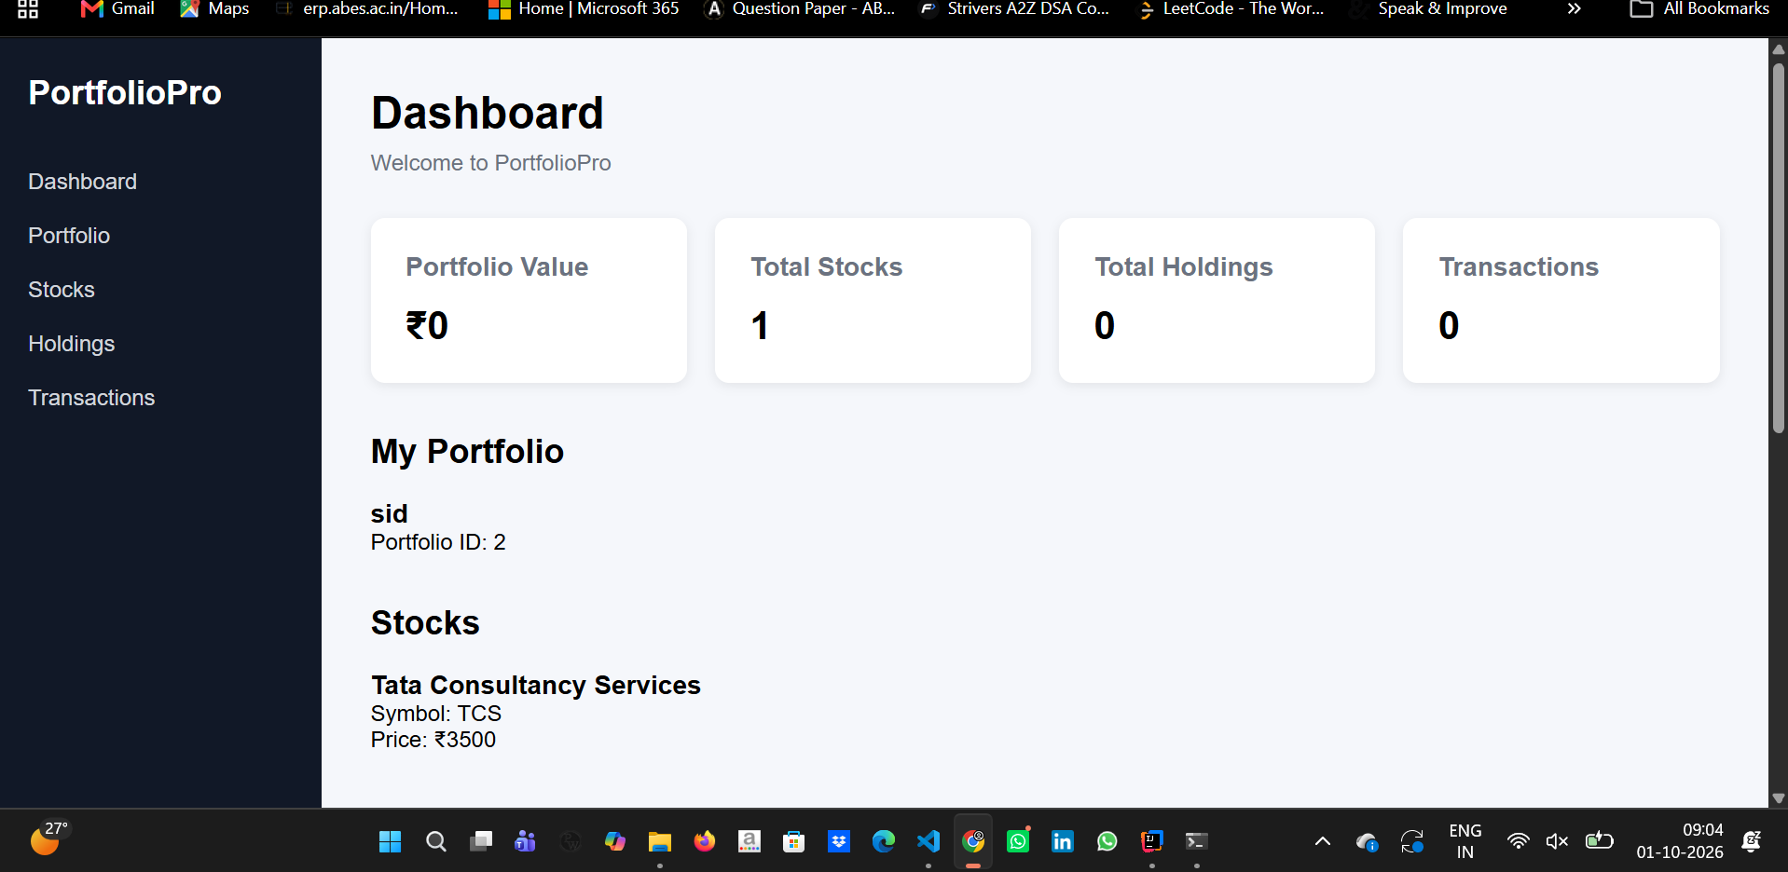
FULL-STACK WEB APPLICATION
PortfolioPro
Stock Trading &
Portfolio Management System
A practical full-stack project connecting Angular, Spring Boot, REST APIs and MySQL.
Angular
Spring Boot
MySQL
REST API
B.Tech CSE Project
01

Slide 2
01 | WHY THIS PROJECT
From scattered investment data to one connected workflow
PortfolioPro brings portfolio, stock, holding and transaction information into a single application.
THE CHALLENGE
THE SOLUTION
• Investment information is easy to fragment across separate records or screens.
• Users need a central place to track portfolios and stock positions.
• The frontend must stay synchronized with backend data and the database.
1
Centralized
2
API-driven
→
One dashboard for connected investment data.
Angular communicates with Spring Boot REST APIs.
3
Persistent
4
Modular
MySQL stores data through JPA/Hibernate.
Controller → Service → Repository architecture.
Problem space
Solution
02

Slide 3
02 | PRODUCT
What PortfolioPro actually lets a user do
The project is organized around the five core data domains used by the application.
P
Portfolio management
S
Stock catalog
H
Holdings
Create and view portfolios linked to a user.
Store stock symbol, company name and price.
Track quantities of stocks held in a portfolio.
T
Transactions
D
Dashboard
A
API connectivity
Store buy/sell activity and transaction values.
See counts and portfolio information at a glance.
Move data between Angular, Spring Boot and MySQL.
03

Slide 4
03 | ARCHITECTURE
A clean request path from UI to database
Each layer has one job, making the system easier to understand, test and extend.
ANGULAR
REST API
CONTROLLER
SERVICE
REPOSITORY
JPA / HIBERNATE
MYSQL
UI + HTTP
GET / POST / PUT / DELETE
Request handling
Application logic
Data access
ORM mapping
Persistent data
Why this matters
The frontend does not talk directly to MySQL. Every request flows through the backend API and its service/repository layers.
04

Slide 5
04 | DATA MODEL
The five entities behind the application
The relational model connects users to portfolios, portfolios to holdings/transactions, and stocks to activity.
User
Portfolio
Stock
id
name
email
id
portfolioName
user_id
id
symbol
companyName
price
Holding
Transaction
id
quantity
...
id
quantity
price
...
Core idea
Relationships are represented with JPA annotations and persisted as relational tables in MySQL.
*via holdings / transactions
05

Slide 6
05 | BACKEND ENGINEERING
CRUD + REST APIs, not just a static UI
The backend exposes modular endpoints while keeping database access inside the repository layer.
MODULE
CREATE
READ
UPDATE
DELETE
Example API
Users
POST
GET
Service
GET /stocks
Service
Returns stock data from Spring Boot → JPA/Hibernate → MySQL.
Portfolios
POST
GET
PUT
DELETE
Stocks
POST
GET
PUT
DELETE
REST
JPA
MySQL
Holdings
POST
GET
PUT
DELETE
Tested with Postman during development.
Transactions
POST
GET
PUT
DELETE
06

Slide 7
06 | WORKING PRODUCT
Frontend + backend integration is live
This is the working Angular dashboard connected to the Spring Boot backend.
LIVE DATA
Stocks
1
Portfolio
1
Holdings
0
Transactions
0
The screenshot reflects the current working demo state.
07

Slide 8
07 | DEMO FLOW
How to explain the project in 60 seconds
A concise story keeps the presentation focused on architecture + working behavior.
01
Open dashboard
02
Open Stocks
03
Open Portfolio
Show the Angular UI and KPI cards.
Show TCS coming from the API/database.
Show the stored portfolio and creation flow.
04
Open Holdings
05
Open Transactions
06
Explain stack
Explain the quantity-based position model.
Explain how activity is stored and retrieved.
Angular → Spring Boot → JPA → MySQL.
08

Slide 9
08 | NEXT
From academic project to a stronger product
Future improvements can build on the same architecture without changing the core design.
NOW
Full-stack CRUD + live API integration
NEXT
Authentication & authorization
NEXT
Real-time stock price integration
LATER
Portfolio analytics + performance charts
PortfolioPro shows how a real frontend, REST backend and relational database fit together as one system.
09

